Slide 1

Analysing the Randomness of Social Media
By Thomas Plumpton
1500936

Slide 2
Project Overview & Objectives
Overview
Objectives
Twitch Plays Pokémon
Twitter & Robocode
Java Program
NodeJS Web Application
Statistical Analysis
Differentiate PRNG vs TRNG
Create a Random Number Generator
Program Robocode AI
Visualise & Analyse Data
Form a Conclusion
Overview
Java Program
NodeJS
Results
Reflection
1
2
3
4
5

Slide 3


Justification of Technologies
Java SE (Standard Edition) Version 9
Overview
Java Program
NodeJS
Results
Reflection
1
2
3
4
5
Notes:
Robocode robots could be developed in Microsoft .NET or Java.
Simply chose Java as I was familiar with it and felt that learning a new language would add too much academic challenge and become overwhelming.

Slide 4




Justification of Technologies
MEAN Stack (MongoDB, ExpressJS, AngularJS, NodeJS)
Overview
Java Program
NodeJS
Results
Reflection
1
2
3
4
5

Slide 5

Justification of Technologies
D3 (Data Driven Documents) JavaScript Library
Overview
Java Program
NodeJS
Results
Reflection
1
2
3
4
5

Slide 6


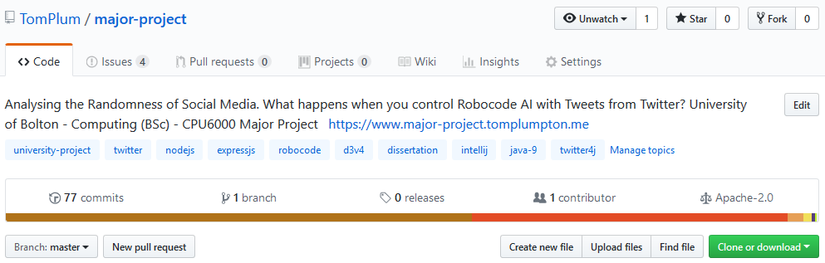
Justification of Technologies
Git Version Control & GitHub
Overview
Java Program
NodeJS
Results
Reflection
1
2
3
4
5

Slide 7


Development: Java Program
Twitter API (twitter-4j)
MongoDB Atlas Cluster (mongodb-java-driver)
Overview
Java Program
NodeJS
Results
Reflection
1
2
3
4
5

Slide 8
Development: Java Program
Twitter Package
Download Tweets
Serialise Tweets
Read Tweets
Sanitise Tweets
Parse Tweets
Overview
Java Program
NodeJS
Results
Reflection
1
2
3
4
5

Slide 9
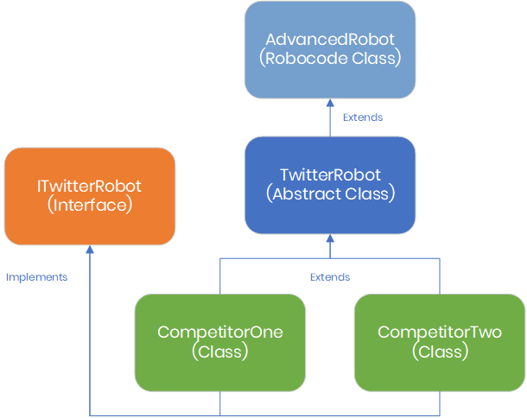

Development: Java Program
Robocode Package
Configure & Launch Battle
Custom Robot Classes
Robot Controller
Store Results
Loop Battle Simulation
Overview
Java Program
NodeJS
Results
Reflection
1
2
3
4
5
Notes:
Create a pseudo-class diagram that shows the relationship between the TwitterRobot abstract class, interface and classes + robot controller.

Slide 10
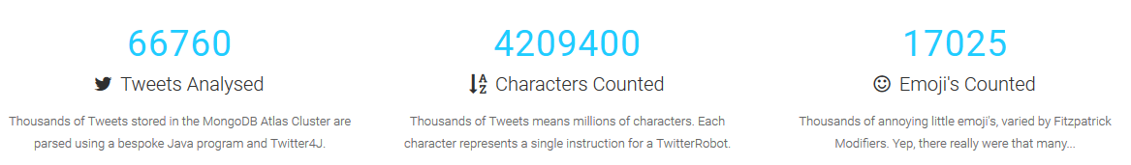
Development: Web Application
Statistical Overview
Overview
Java Program
NodeJS
Results
Reflection
1
2
3
4
5

Slide 11
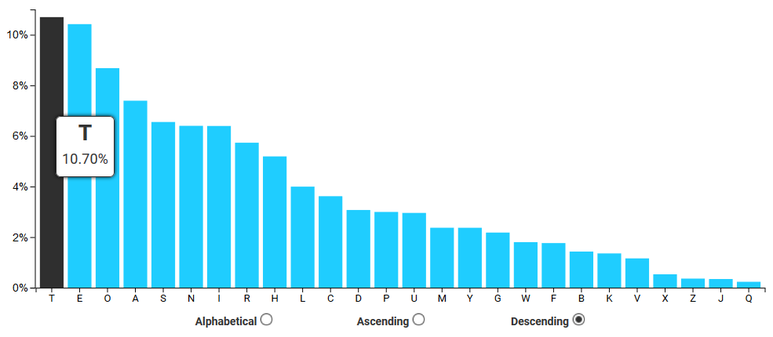
Development: Web Application
Character Frequency Visualisation
Overview
Java Program
NodeJS
Results
Reflection
1
2
3
4
5

Slide 12
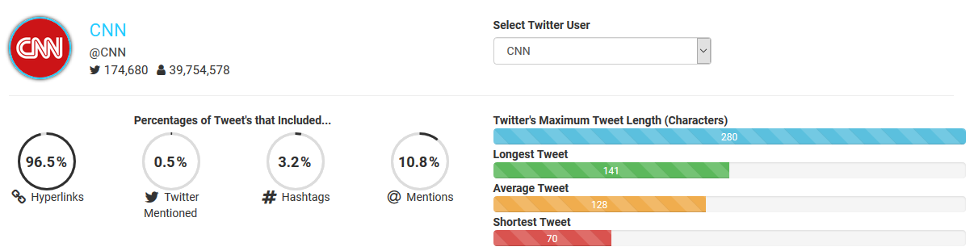
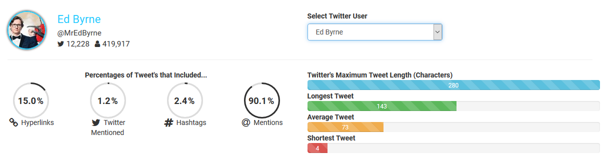
Development: Web Application
Twitter User Breakdown
Overview
Java Program
NodeJS
Results
Reflection
1
2
3
4
5

Slide 13
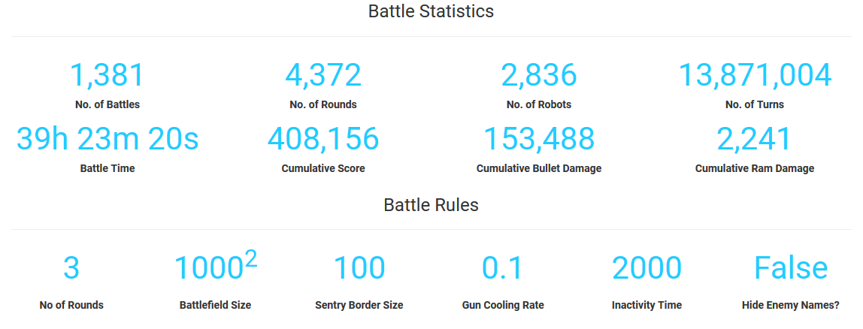
Development: Web Application
Battle Statistics Overview
Overview
Java Program
NodeJS
Results
Reflection
1
2
3
4
5

Slide 14
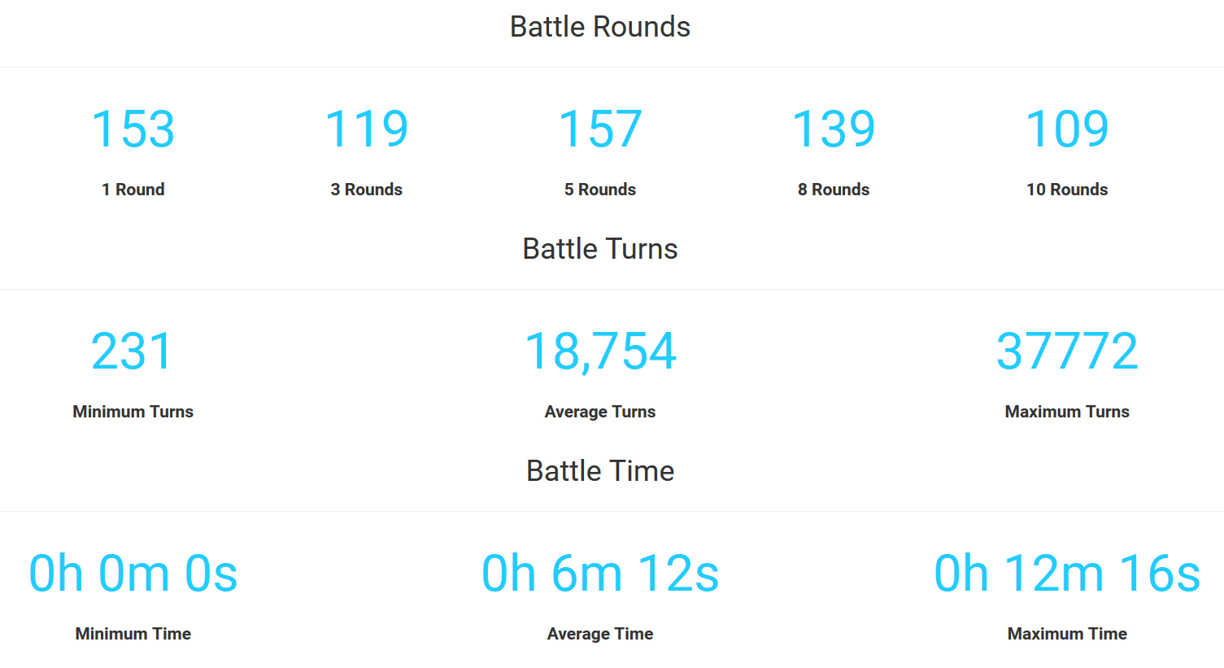
Development: Web Application
Battle Statistics Breakdown
Overview
Java Program
NodeJS
Results
Reflection
1
2
3
4
5

Slide 15
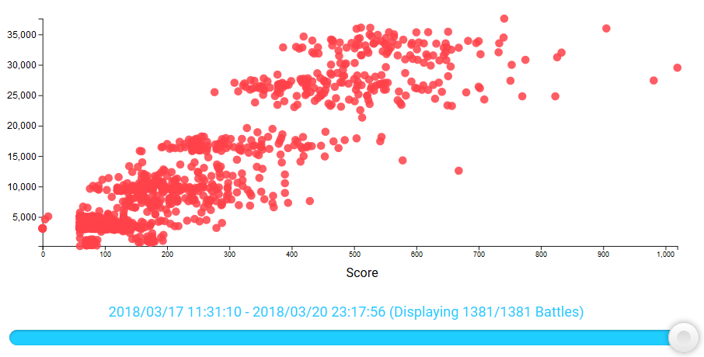
Development: Web Application
Scatter Plot Diagram
Overview
Java Program
NodeJS
Results
Reflection
1
2
3
4
5

Slide 16
Project Results & Conclusion
Short Answer
Pseudo-Random
Long Answer
…
Overview
Java Program
NodeJS
Results
Reflection
1
2
3
4
5

Slide 17
Reflection
Positives
Negatives
Developing the Web Application
Project Management & Organisation
Drawing a Conclusion
Academic Challenge
Issues with Robocode & Java
Time Limitations
D3.JS Performance
Academic Challenge
Motivation
Overcoming Issues
Technical Skills
Overview
Java Program
NodeJS
Results
Reflection
1
2
3
4
5

Slide 18
Thankyou for Listening
Any Questions?

